Slide 1
Introduction to Firewalls and Network Security
Networks Security Day 1

Slide 2
Today’s Objectives
By the end of class, you will be able to:
Explain the relationship between ports and services.
Describe how open ports contribute to a machine’s attack surface.
Explain how firewalls can be used to protect a machine’s open ports.
Develop and implement firewall policies with UFW and firewalld.

Slide 3
Restricting access to open ports is a fundamental skill for any technical security specialist.

Slide 4
Introduction and Professional Application
The ability to read and write firewall rules is expected for the following cyber professions:
Help Desk / IT Specialists
System / Network Administrators
SOC Analysts
Penetration Tester

Slide 5
Professional Application
Help Desk / IT Specialist
Entry-level IT roles focus more on troubleshooting user issues than implementing network controls. However, being able to determine if and how firewalls affect user traffic can help when troubleshooting issues like:
a slow connection
an unexpected lack of a connection
broken networked applications such as Skype or Facebook Messenger

Slide 6
Professional Application
System/Network Administrator
System and Network Administrators are usually in charge of determining who should be allowed to access which devices on the network.
People in these roles must be able to develop firewall policies by determining which ports to open and which to close.
They must also be able to implement these policies, using tools ufw or firewalld.

Slide 7
Professional Application
SOC Analyst
While SOC Analysts don't develop or implement firewall rules as a primary responsibility, they must be able to understand how firewalls on the network filter incoming and outgoing packets in order to accurately interpret the traffic logs they monitor for incidents.
Without this knowledge, they wouldn't be able to identify abnormal network traffic as readily.
It also enables them to direct IT personnel as to how to modify their firewall policies to mitigate future attacks, in the event a particular firewall policy is found to be ineffective in practice.

Slide 8
Professional Application
Penetration Tester
Penetration Testers also do not usually implement firewall rules themselves.
However, launching a successful attack against a network requires that they are able to determine whether a firewall sit between them and their target.
If so, they must deduce which rules are enabled base on the results of their probing.
Therefore, they can determine ways to identify ways to bypass the firewall and continue with their attack.

Slide 9
Ports, Services and Firewalls

Slide 10
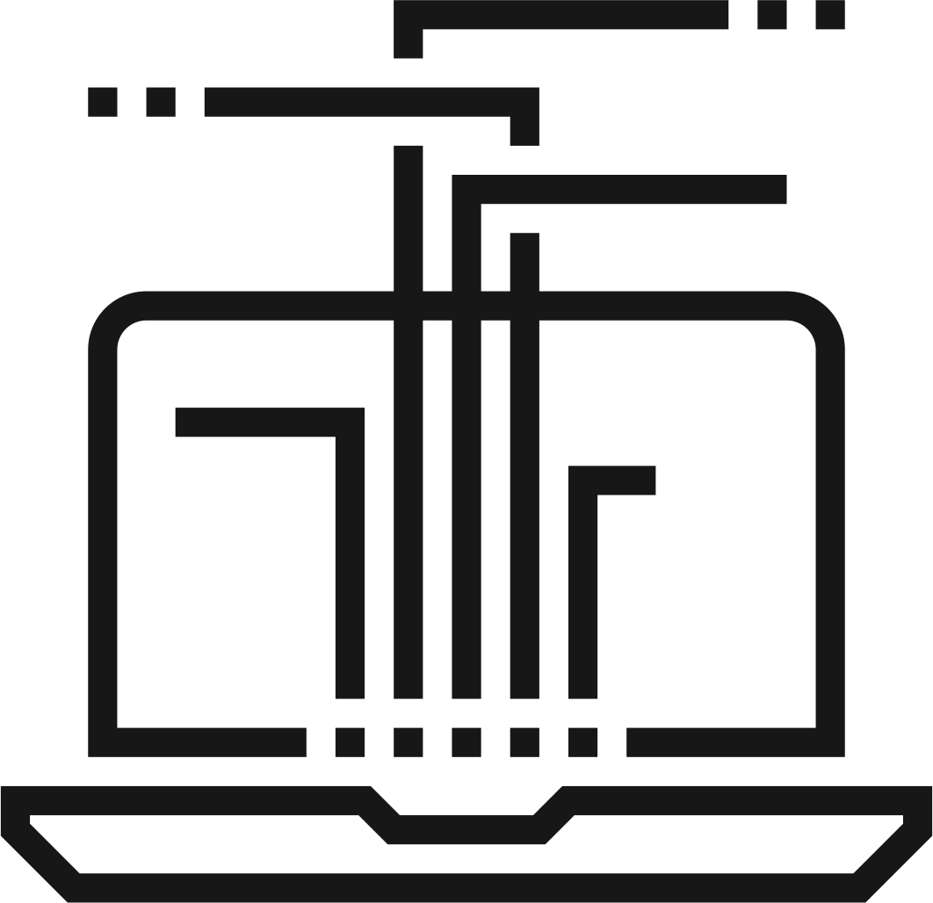


Review of Ports and Services
Ports are essentially pathways into a machine’s file system, allowing machines to send and receive data to each other.
Computers use ports by starting a program that needs to communicate on the network, then binding that program to its own specific port.
Open ports, like 80 (HTTP) and 443 (HTTPS), pose security vulnerabilities, as attackers can send malicious data containing SQL injections, XSS payloads, etc.
These threats can be mitigated through access controls.

Slide 11
How Ports and Services Work
Ports are essentially pathways into a machine’s file system, allowing machines to send and receive data to each other.
Computers use these ports by initiating programs that need to communicate on the network and then binding those programs to their own specific port.
For example: A user might start SSH on port 22.
The port number 22 acts like the “name” for the SSH server
When another device wants to communicate, it sends a message to <IP Address>: 22
Ports can be open or closed.
When ports are not bound to service, they are considered closed and will not be able to receive data.
If a port is open, it will be able to send and receive data, but it also poses a security risk.

Slide 12
Open Port Vulnerability
Public servers must open port 80 (HTTP) and 443 (HTTPS).
HTTP server cannot whitelist IP addresses:
Suppose a web server is running a vulnerable version of WordPress. In this case, anyone who requests the site will have access to the vulnerable application.
Attackers can send requests to this site and use a SQL injection or something similar to take over the web server.
This is a common real-world scenario and ultimately possible because the web server had to open ports 80 and 443, but wasn't able to filter malicious users from genuine users.
SSH is also vulnerable to exploits like brute-force passwords and stolen keys.

Slide 13
Securing the Server Through Access Controls
Access control can mitigate these threats to SSH and HTTP servers.
The SSH server can be protected by only allowing specific IP addresses to connect.
For example: The server might only accept connections to port 22 from the administrator’s known IP address of 172.16.5.10 and deny attempts to connect from any other addresses.
Protecting the SSH server by allowing only one IP address to connect is an access control because it restricts access to SSH to only a single host.
The HTTP server can be protected by detecting and dropping specific traffic.
Dropping suspicious HTTP traffic is an access control because it restricts access to ports 80 and 443 to only hosts that send benign traffic.

Slide 14

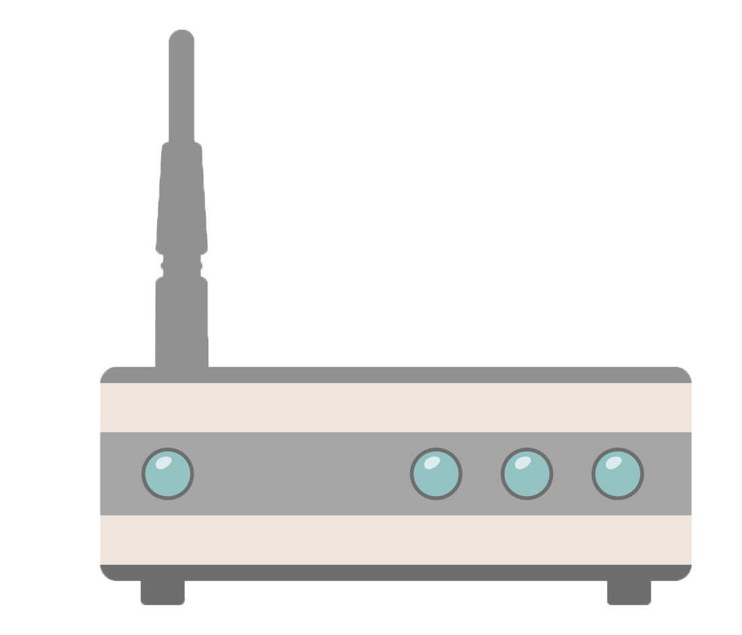


Firewalls
Administrators would use firewalls to control access to SSH servers.
Firewalls are devices or software that function as packet filters to intercept TCP and UDP packets as they enter a network, allow trusted packets through and then drop the rest.
Firewalls usually work by reading OSI layer 3 (Networking) and Layer 4 (Transport)

Slide 15
Firewalls
Administrators would use a web application firewall (WAF) to protect the HTTP server.
A WAF is specifically designed to understand threatening activity.
It can identify suspicious HTTP traffic, log information about it, and drop it before it gets to the target server.
Typically, firewalls only understand Layer 3-4 traffic. However, web applications communicate with HTTP, which is a Layer 7 protocol.
Therefore, a firewall protecting a web server needs to understand application-layer (7) protocols.

Slide 16
Firewalls
Firewalls can be used to control access to either a single host (host-based firewall) or an entire network (network firewall).
A host-based firewall runs on the computers that they are meant to protect and block traffic to/from that specific device.
A network firewall is often placed in front of a router, in order to block malicious traffic from entering a private network.
These two types of firewall work in the same way, by:
Intercepting traffic before it reaches a target host,
Inspect the source and destination addresses / ports, TCP flags, and other features of the incoming packets.
Allow packets that come from trusted sources and deny packets that don’t.

Slide 17
Firewall Rules
Firewalls decide which packets to allow or deny by applying rules to each packet.
A firewall rule is essentially a description of the kinds of packets that should be allowed or denied.
Firewalls apply these rules by reading the source and destination information.
It then determines whether to allow or reject the packet by comparing that information to the list of hosts it already knows to allow or deny.
For example: Administrator can protect the SSH server by restricting access to port 22 to only 172.16.5.5.
In this case, the rule would be: “If the packet comes from 172.16.5.5 and is bound for 172.15.5.10:32, allow it into the network. Otherwise reject it.

Slide 18
Firewall Rules
Other firewall rules include:
"If this TCP packet comes from the subnet 172.16.5.0/24, allow it into the network. Otherwise, reject it."
"If this TCP packet comes from the IP address 216.58.193.175, reject it."
"If this TCP packet has every TCP flag set, reject it.”
"If this TCP packet was sent less than 1ms after another packet from the same host, reject it."

Slide 19
Firewalls: Stateful and Stateless
Stateful firewalls monitor the whole TCP connection, instead of just its constituent packets.
A series of related TCP packets are a TCP Stream, which are transferred over TCP Connections.
Application protocols like HTTP involve transferring large amounts of data over TCP connections.
7
Data
Application
6
Data
Presentation
5
Data
Session
4
Segments
Transport
Stateless firewalls allow or reject traffic on a “per-packet” basis.
Applies rules by reading source and destination data of Layer 3 and Layer 4 level information
“State-less” because they do not “remember” anything about previous packets they’ve seen.
3
Packets
Network
2
Frames
Data Link
1
Bits
Physical

Slide 20
Stateless Firewalls
Firewalls can inspect almost any feature of incoming packets, the most important features being:
Source/Destination IP/MAC Addresses
Does the packet comes from a device in a trusted subnet or is the response to a request made from a trusted device?
TCP Flags
Malicious packets often have non-standard TCP flag settings.
For example: Hacking tools like Nmap’s Xmas scan set non-standard combinations of TCP flags to bypass firewalls.
Malformed or Corrupt Data
Attackers sometimes send specially crafted malformed or corrupted data as part of an attack. Firewalls can be configured to deny packets containing this type data.
Transmission Rate
Firewalls can be configured to block traffic from machines that send too many packets too quickly.
For example: an administrator might configure a web server to accept traffic from any IP address, but block traffic from any host that sends more than 100 requests in one second.
This process is called rate limiting or request throttling.

Slide 21
Stateful Firewalls
Inspecting the whole data stream allows stateful firewalls to detect more information:
If a packet is trying to establish a new connection. (New State)
If a packet is part of an existing connection. (Established State)
Is a packet is rouge. (Neither opening a new or part of an established)
Which protocol is in use.

Slide 22
FTP / Stateful Firewall Process
File Transfer Protocol (FTP) is used to transfer files between machines, usually running on port 21.
FTP Command Channel: When a client wants to download a file, they connect to the server’s port 21 and requests a file, with a command like GET myfile.txt.
The server opens a new connection back to the client, separate from the FTP Command Channel.
FTP Data Channel: To open this connection, the server chooses a random port on the client to send the file to.
After the file download completes, the server and client tear down the FTP data channel.
From here, the user can continue to use the command channel to download/upload other files.

Slide 23
UFW

Slide 24
UFW
Most operating systems come with a built-in firewall solution. On Linux, the de facto firewall is Uncomplicated FireWall (UFW). Features include:
Configuring Allow/Deny rules
For example: An administrator might automatically drop packets bound to any port they have not explicitly opened.
Logging Dropped and Suspicious Packets
Helpful for determining if dropped packets were sent in honest error or as part of an attack.
Rate-Limiting Incoming Traffic
Helpful for preventing denial-of-service (DoS) conditions and brute-force attacks.
Automatically Setting rules for Common Applications
Admins can install “application profiles” for UFW, which are pre-made lists of common rules for common applications.

Slide 25
UFW
Enabling UFW
Setting Default Rules
Allow and Deny Rules
Deleting Rules

Slide 26
UFW Demo
1. Enabling UFW
UFW isn’t initiated by default. Admins need to enable it themselves.
Verify the status of the firewall (active or inactive) by running sudo ufw status
UFW commands require sudo rights, because manipulating the firewall affects all users on the system.
Start UFW by running sudo ufw enable

Slide 27
UFW Demo
2. Setting Default Rules
Once UFW is running, admin’s typically set default rules.
Default rules are applied to packets that administrators have not applied specific rules to.
For example: An administrator might set a rule that allows SSH traffic to a server’s port 22.
Rather than write an explicit rule denying traffic to every other port, they can protect the machine by setting a “default deny” rule.
This rule drops all incoming packets except for those bound for port 22.
A secure firewall policy should deny all incoming and outgoing packets by default. Then, administrators should open only the ports they know.
$ sudo ufw default deny incoming
$ sudo ufw default deny outgoing

Slide 28
UFW Demo
3. Allow and Deny Rules
Denying all incoming and outgoing traffic immediately breaks all networked applications, since it prevents them from sending or receiving data.
To remedy this, administrators need to explicitly allow traffic to/from the ports they expect users to need.
For example: enabling web browsing means allowing traffic to/from ports 80 and 443.
sudo ufw allow 80
sudo ufw allow 443
sudo ufw deny 80

Slide 29
UFW Demo
4. Deleting Rules
You can delete firewall rules once they are no longer necessary, or if there were erroneously configured.
To delete a rule, append delete to the beginning of the command.
sudo ufw delete deny 80
To see that the rule is gone, list all enabled rules: sudo ufw status verbose
You must start and restart the firewall for their changes to take effect:
$ sudo ufw disable
$ sudo ufw start

Slide 30
Activity: Configuring UFW
In this activity, you will act as a system administrator tasked with securing an administration server on your company’s internal network.
Instructions sent via Slack.
35 Minutes

Slide 31
Configuring UFW

Slide 33
firewalld

Slide 34
firewalld is a service to test and update firewall rules across interfaces without restarting the firewall to implement the new rule.

Slide 35
Firewalld
Firewalld does not require users to restart their firewall when implementing new rules.
Like UFW, firewalld loads rules from a database before filtering packets.
Unlike UFW, firewalld allows administrators to change those rules on the fly.
When rules are changes, firewalld will immediately use the updated rules until it is changed again, or the server is shut down.
Then, when firewall is restarted, it will default to the original rules of the database.

Slide 36
Firewalld Zones and Services
Firewalld incorporates network zones to simplify organizing rules.
Different interfaces might need to implement different firewall policies, because each might provision different services.
It can be difficult to keep track of which rules correspond to which interfaces.
Firewalld requires you to associate each interface with a zone.
Rules are written in a zone and only apply to the interface associated with the zone.
Firewalld uses services to act as shortcuts to configure rules for common services.
For example: if you enable the SSH service in a zone, it will open port 22 without needing to specify the port number.

Slide 37
firewalld

Slide 38
Firewalld Commands
List all zones: sudo firewall-cmd --list-all-zones
Assign an interface to a zone : sudo firewall-cmd --zone=<ZONE> --change-interface=eth1
List all service: sudo firewall-cmd --get-services
List all active rules in a zone: sudo firewall-cmd --zone=<ZONE> --list-all
Set a rule with a command like:
sudo firewall-cmd --zone=work --add-rich-rule=’rule family=”ipv4” source address=”10.10.10.10” reject
This rule blocks all traffic from 10.10.10.10 in the work zone.

Slide 39
Activity: Configuring firewalld
In this activity, you will continue to act as a system administrator tasked with updating a firewall to implement different rules for different zones.
Instructions sent via Slack.
35 Minutes

Slide 40
firewalld

Slide 41
Professional Application
Let’s review some of the professionals roles that are relevant to today’s lesson.
Help Desk / IT Specialists
System / Network Administrators
SOC Analysts
Penetration Tester

Slide 42
Today’s Objectives
By the end of class, you will be able to:
Explain the relationship between ports and services.
Describe how open ports contribute to a machine’s attack surface.
Explain how firewalls can be used to protect a machine’s open ports.
Develop and implement firewall policies with UFW and firewalld.

